Slide 1
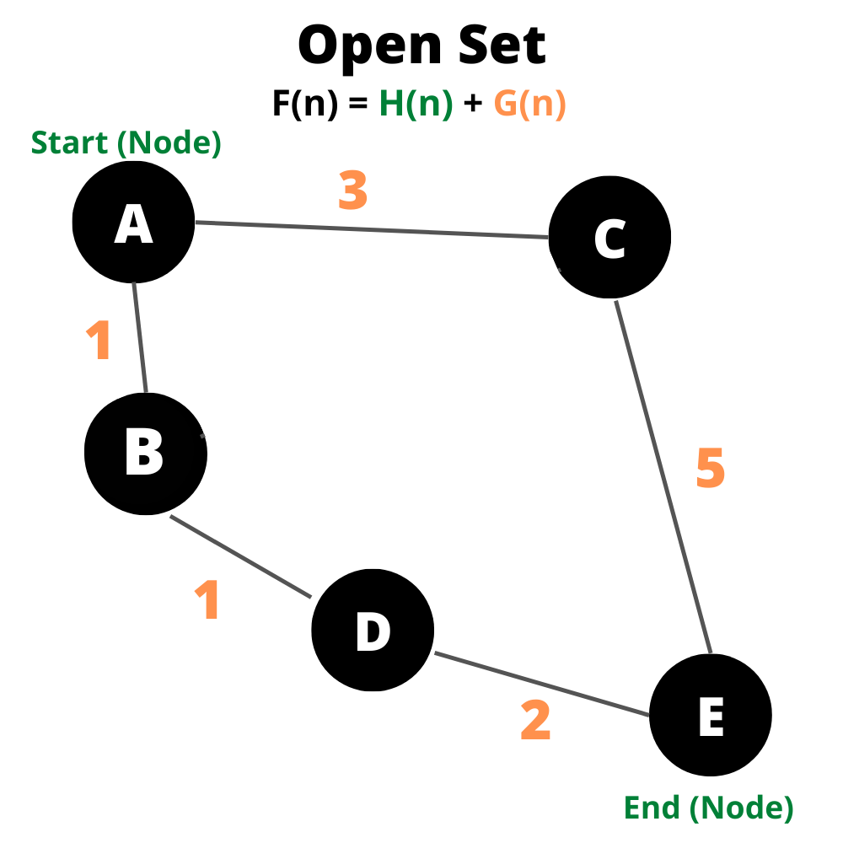
Informed Search algorithm formula
F(n) = H(n) + G(n)
Score/n: (Manhattan Distance Heuristic). Estimates the distance from the node to the end
G-Score/n: calculates the shortest distance from the current node to the next node

Slide 2
The table displays how the algorithm works. From node A, there are two options, B & C. B has a lower F score therefore it selects node B. And then from node B, there’s only one other option (Node D). This concept is actually very simple when decomposed. The algorithm will do this at a much larger scale with much more nodes.
Nodes | G | H | F | Last
A | 0 | 0 | 0 | -
B | 1 | 3 | 4 | A
C | 3 | 5 | 8 | A
D | 2 | 0 | 2 | B
E | ∞ | ∞ | ∞ | D

